Slide 1
ICT-LEARNFACTORY
Multi-User-Applikationen
objektorientiert realisieren
Multi-Userfähigkeit
08/16/26
Notes:
[Sources]
- Redesign follows the supplied ICT-LearnFactory Brand Guide (Aptos typography; Charcoal Flux #272726, Hyper Teal #45D9C7, Lumen Zest #D9EB12, Abyss Teal #29948C; geometric brand-mark pattern language).
- Slide content is preserved from the uploaded source presentation 06_Multiuser.odp.
[/Sources]

Slide 2
Handlungsnotwendige Kenntnisse
1.1 Kennt Anforderungen an das Datenbankmanagement-System bezüglich Multi-User-Fähigkeit.
3.2 Kennt Möglichkeiten ein mehrbenutzer-fähiges Rechtemanagement zu implementieren.
ICT-LEARNFACTORY
Multiuser
Notes:
[Sources]
- Redesign follows the supplied ICT-LearnFactory Brand Guide (Aptos typography; Charcoal Flux #272726, Hyper Teal #45D9C7, Lumen Zest #D9EB12, Abyss Teal #29948C; geometric brand-mark pattern language).
- Slide content is preserved from the uploaded source presentation 06_Multiuser.odp.
[/Sources]

Slide 3
Ziele
Du kennst die wichtigsten Aspekte einer Multiuserfähigen Applikation
Du kennst die Herausforderungen im Zusammenhang mit Multiuserfähigkeit
Du kannst Benutzer in der Datenbank anlegen und berechtigen
ICT-LEARNFACTORY
Multiuser
Notes:
[Sources]
- Redesign follows the supplied ICT-LearnFactory Brand Guide (Aptos typography; Charcoal Flux #272726, Hyper Teal #45D9C7, Lumen Zest #D9EB12, Abyss Teal #29948C; geometric brand-mark pattern language).
- Slide content is preserved from the uploaded source presentation 06_Multiuser.odp.
[/Sources]

Slide 4
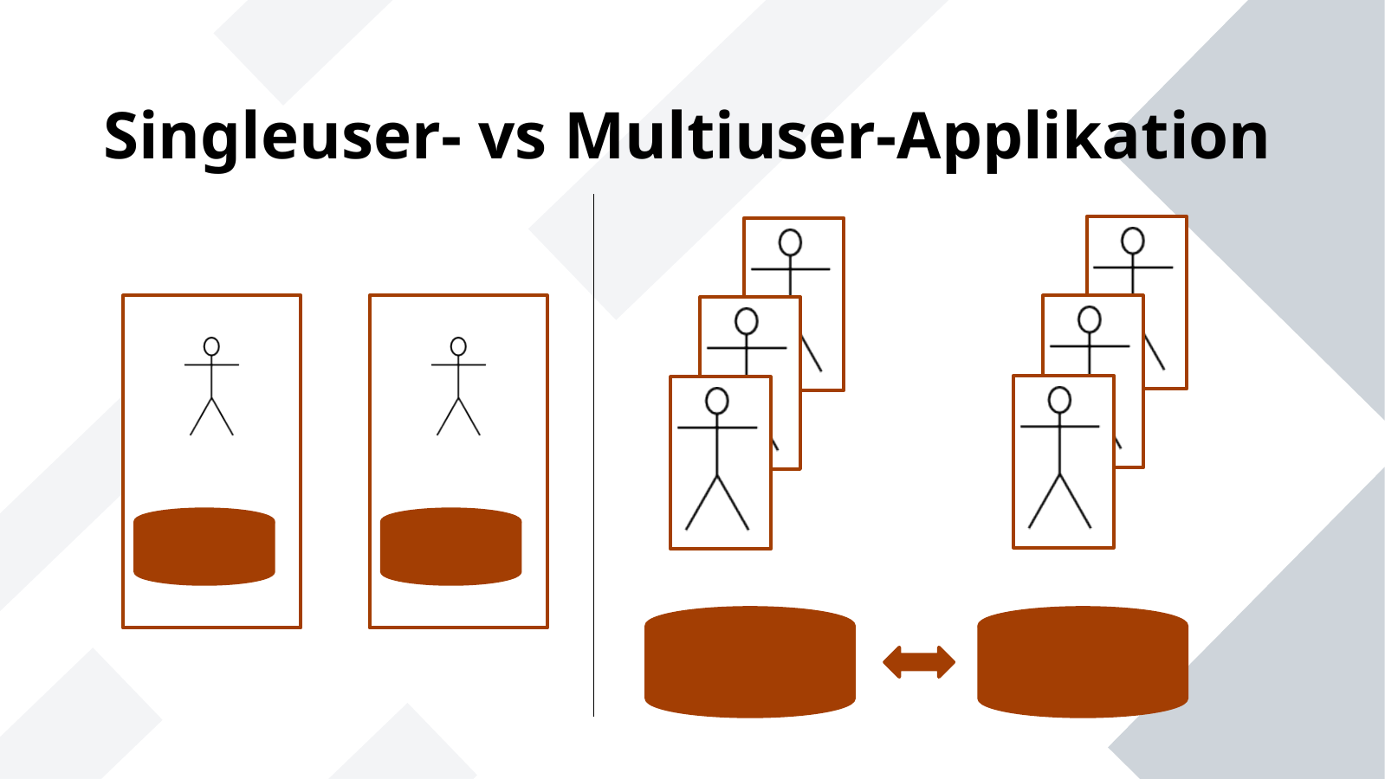
Singleuser- vs Multiuser-Applikation
ICT-LEARNFACTORY
Multiuser
Notes:
[Sources]
- Redesign follows the supplied ICT-LearnFactory Brand Guide (Aptos typography; Charcoal Flux #272726, Hyper Teal #45D9C7, Lumen Zest #D9EB12, Abyss Teal #29948C; geometric brand-mark pattern language).
- Slide content is preserved from the uploaded source presentation 06_Multiuser.odp.
[/Sources]

Slide 5
Multiusersysteme
Herausforderungen - Security
Authentifizierung
Authorisierung (Rollen und Berechtigungen)
Verschlüsselung und Hashing
Logging
Testing
ICT-LEARNFACTORY
Multiuser
Notes:
[Sources]
- Redesign follows the supplied ICT-LearnFactory Brand Guide (Aptos typography; Charcoal Flux #272726, Hyper Teal #45D9C7, Lumen Zest #D9EB12, Abyss Teal #29948C; geometric brand-mark pattern language).
- Slide content is preserved from the uploaded source presentation 06_Multiuser.odp.
[/Sources]

Slide 6
Multiusersysteme
Herausforderungen - Performance
Kurze Antwortzeit
Ressourcensparend
Stabilität
Hoher Datendurchsatz
Hohe Verfügbarkeit
Infrastruktur
Netzwerk
Hardware
usw.
ICT-LEARNFACTORY
Multiuser
Notes:
[Sources]
- Redesign follows the supplied ICT-LearnFactory Brand Guide (Aptos typography; Charcoal Flux #272726, Hyper Teal #45D9C7, Lumen Zest #D9EB12, Abyss Teal #29948C; geometric brand-mark pattern language).
- Slide content is preserved from the uploaded source presentation 06_Multiuser.odp.
[/Sources]

Slide 7
Multiusersysteme
Herausforderungen - Portabilität
Unterschiedliche Clients
Desktop Applikation
Mobile Applikation
Webinterface
ICT-LEARNFACTORY
Multiuser
Notes:
[Sources]
- Redesign follows the supplied ICT-LearnFactory Brand Guide (Aptos typography; Charcoal Flux #272726, Hyper Teal #45D9C7, Lumen Zest #D9EB12, Abyss Teal #29948C; geometric brand-mark pattern language).
- Slide content is preserved from the uploaded source presentation 06_Multiuser.odp.
[/Sources]

Slide 8
Multiusersysteme
Herausforderungen - Wartbarkeit
Clean Code
Designpatterns
Testabdeckung
Dokumentation
ICT-LEARNFACTORY
Multiuser
Notes:
[Sources]
- Redesign follows the supplied ICT-LearnFactory Brand Guide (Aptos typography; Charcoal Flux #272726, Hyper Teal #45D9C7, Lumen Zest #D9EB12, Abyss Teal #29948C; geometric brand-mark pattern language).
- Slide content is preserved from the uploaded source presentation 06_Multiuser.odp.
[/Sources]

Slide 9
Multiusersysteme
Nebenläufigkeit
Mehrere Benutzer dürfen sich nicht gegenseitig beim Zugriff auf Ressourcen (DB, File, etc) behindern oder blockieren
Mögliche Szenarien sind unter anderem:
Gegenseitiges Überschreiben der Daten (Lost Update)
Warteabhängigkeit (Deadlock)
Eine multiuserfähige Applikation muss Inkonsistenzen auf Datenebene vermeiden
ICT-LEARNFACTORY
Multiuser
Notes:
[Sources]
- Redesign follows the supplied ICT-LearnFactory Brand Guide (Aptos typography; Charcoal Flux #272726, Hyper Teal #45D9C7, Lumen Zest #D9EB12, Abyss Teal #29948C; geometric brand-mark pattern language).
- Slide content is preserved from the uploaded source presentation 06_Multiuser.odp.
[/Sources]

Slide 10
Multiuserfähige Datenbank
Voraussetzungen
Berechtigungssystem
Unterschiedliche Benutzer
Unterschiedliche Schema
Berechtigungen wie lesen, schreiben, löschen
Netzwerkfähigkeit
Verhinderung von Inkonsistenzen
Transaktionssteuerung
ICT-LEARNFACTORY
Multiuser
Notes:
[Sources]
- Redesign follows the supplied ICT-LearnFactory Brand Guide (Aptos typography; Charcoal Flux #272726, Hyper Teal #45D9C7, Lumen Zest #D9EB12, Abyss Teal #29948C; geometric brand-mark pattern language).
- Slide content is preserved from the uploaded source presentation 06_Multiuser.odp.
[/Sources]

Slide 11
Fragen?
ICT-LEARNFACTORY
Multiuser
Notes:
[Sources]
- Redesign follows the supplied ICT-LearnFactory Brand Guide (Aptos typography; Charcoal Flux #272726, Hyper Teal #45D9C7, Lumen Zest #D9EB12, Abyss Teal #29948C; geometric brand-mark pattern language).
- Slide content is preserved from the uploaded source presentation 06_Multiuser.odp.
[/Sources]

